Slide 1
Amazon Textract
Extract text from documents

Slide 2
What is the price to use this service?

Slide 3
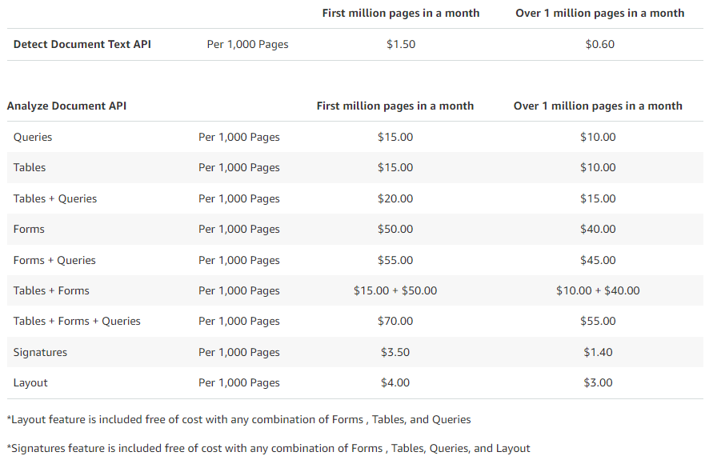
What is the price to use this service?
You pay only for what you use
Free tier
- Detect Document Text API: 1,000 pages per month
1000 Pages per month when using Signatures only
100 Pages per month when using Forms, Tables, and Layout features
100 pages per month each for Queries, Forms + Queries, Tables + Queries, Forms + Tables + Queries
- There is no free-tier for Custom Queries
- Analyze Document API:
- Analyze Expense API: 100 pages per month
- Analyze ID API: 100 pages per month
Pay tier: Europe
Pretrained Features
- Detect Document Text API: 1,000 pages per month
1000 Pages per month when using Signatures only
100 Pages per month when using Forms, Tables, and Layout features
100 pages per month each for Queries, Forms + Queries, Tables + Queries, Forms + Tables + Queries
- There is no free-tier for Custom Queries
- Analyze Document API:
- Analyze Expense API: 100 pages per month
- Analyze ID API: 100 pages per month

Slide 4
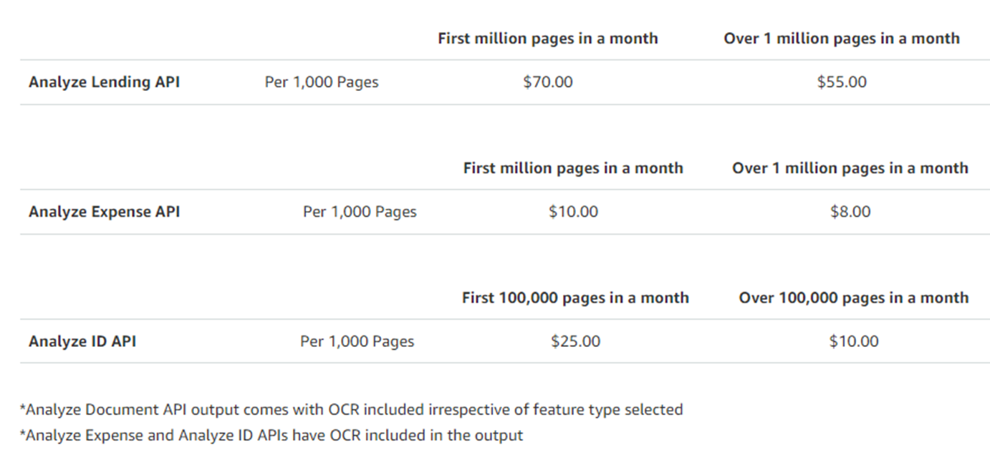
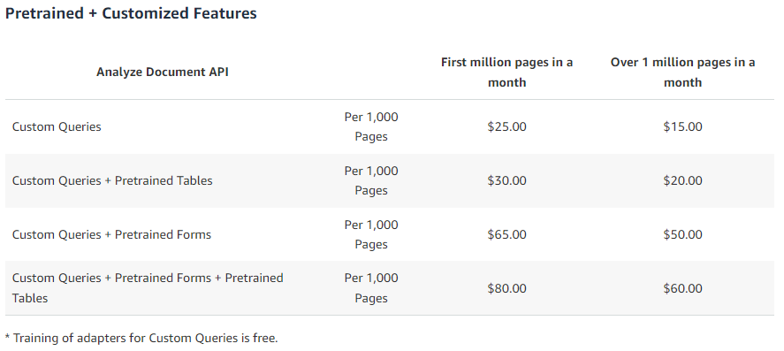
What is the price to use this service?
Pay tier: Europe
Pretrained Features
- Detect Document Text API: 1,000 pages per month
1000 Pages per month when using Signatures only
100 Pages per month when using Forms, Tables, and Layout features
100 pages per month each for Queries, Forms + Queries, Tables + Queries, Forms + Tables + Queries
- There is no free-tier for Custom Queries
- Analyze Document API:
- Analyze Expense API: 100 pages per month
- Analyze ID API: 100 pages per month
Pay tier: Europe
Pretrained + Customized Features
- Detect Document Text API: 1,000 pages per month
1000 Pages per month when using Signatures only
100 Pages per month when using Forms, Tables, and Layout features
100 pages per month each for Queries, Forms + Queries, Tables + Queries, Forms + Tables + Queries
- There is no free-tier for Custom Queries
- Analyze Document API:
- Analyze Expense API: 100 pages per month
- Analyze ID API: 100 pages per month

Slide 5
Can the service be used inside the console and how?

Slide 6
Can the service be used inside the console and how?
Detect Document Text API
Analyze Document API
Forms
Tables
Queries
Signatures
Analyze Expense API
Analyze ID API
Analyze Lending API

Slide 7
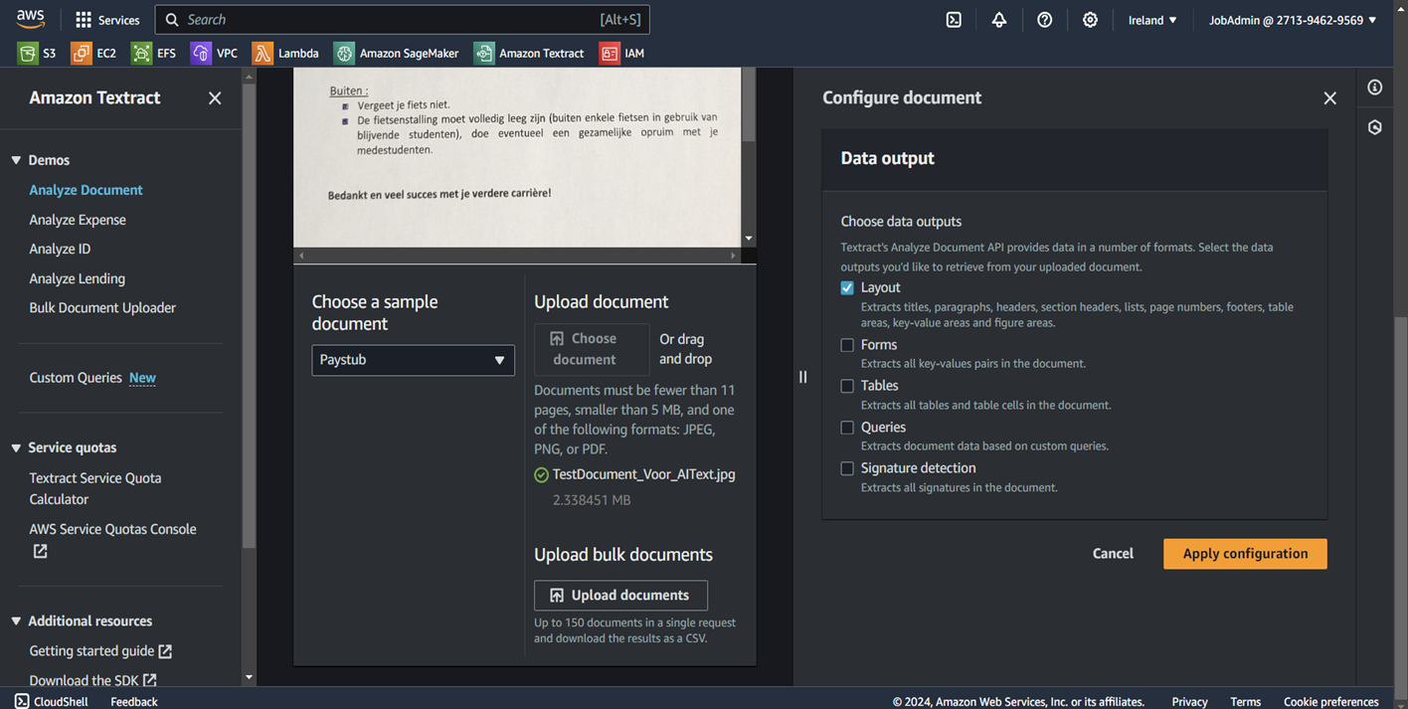
Detect Document Text API 1) Upload document en select data output type

Slide 8
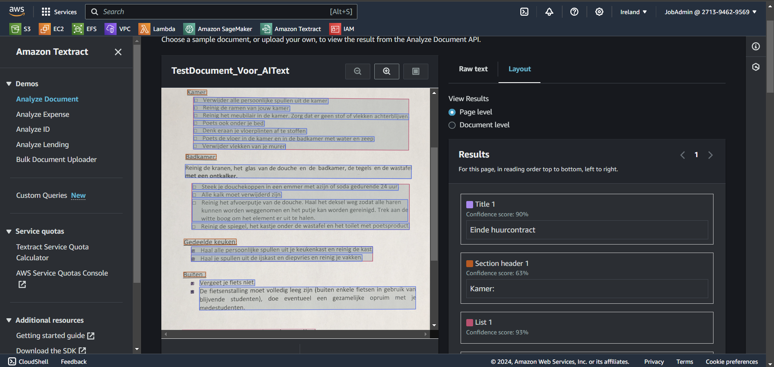
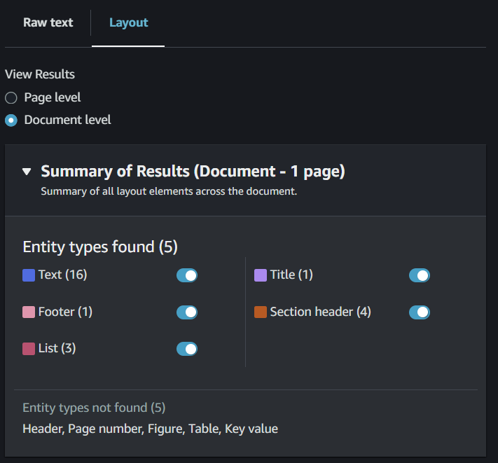
Detect Document Text API 2) Apply configuration ( raw tekst, layout page level-document level

Slide 9
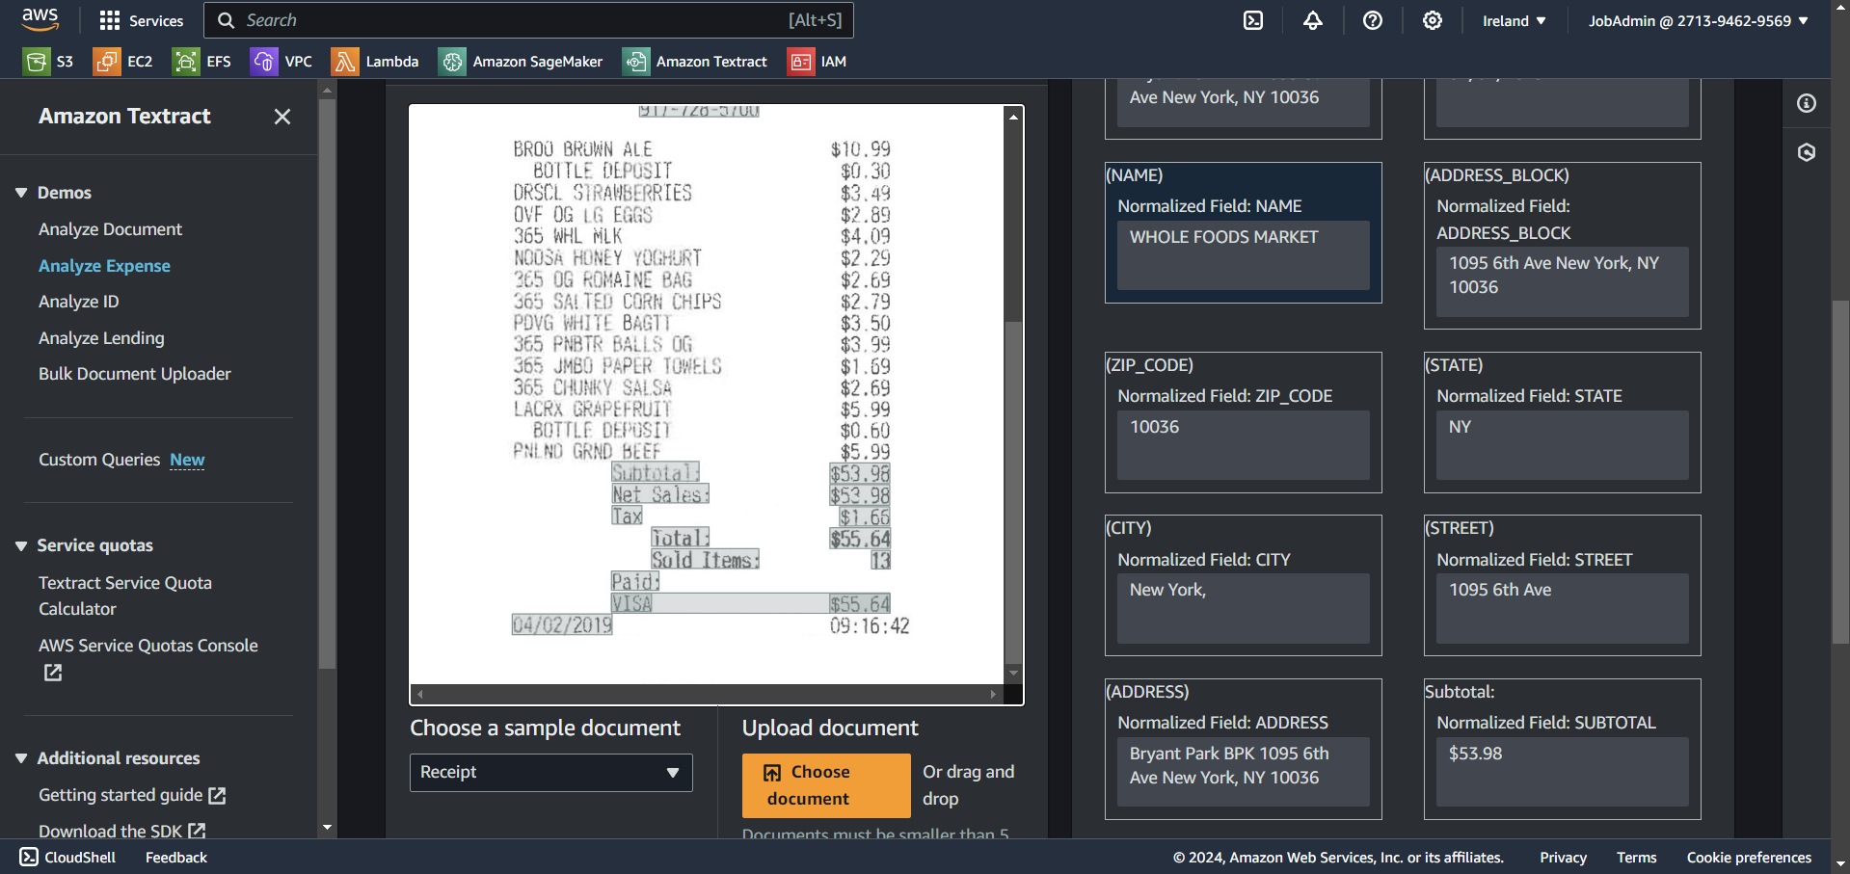
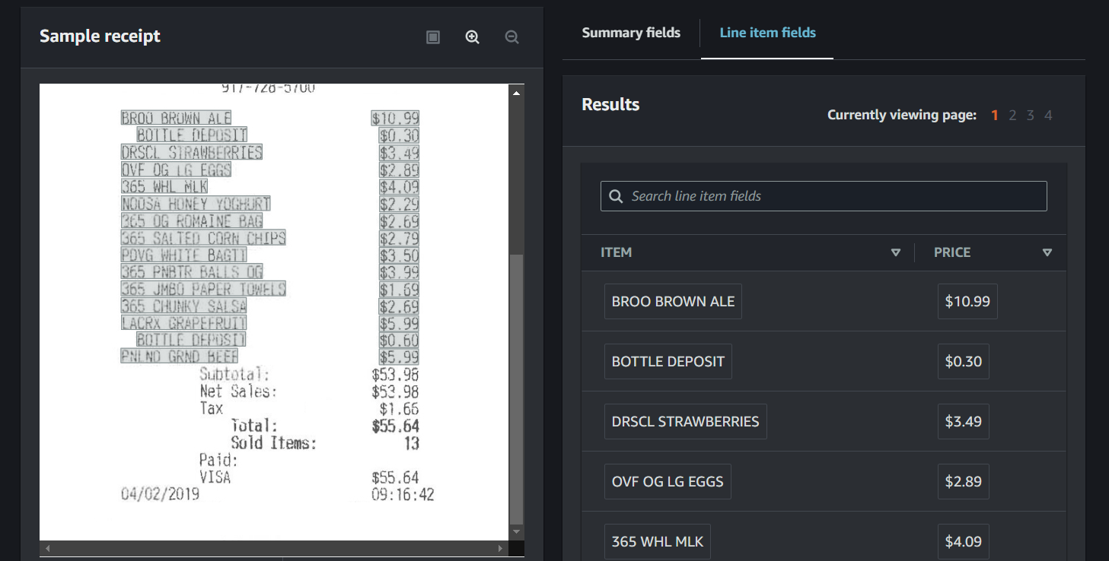
Analyze Expense API 1) summary field and line item fields

Slide 10
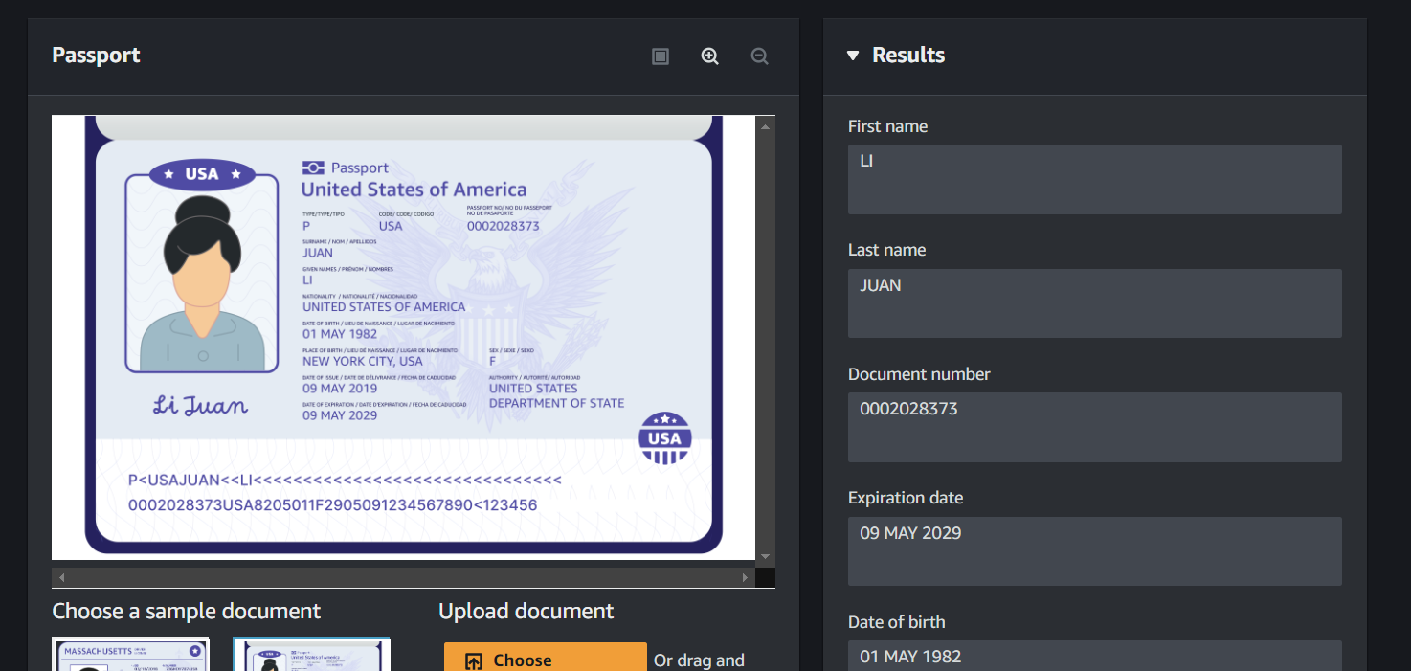
Analyze ID API 1) Results bij het geven van ID

Slide 11
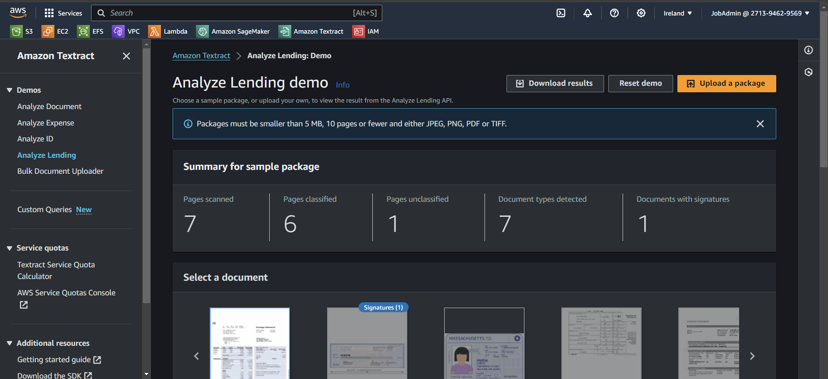
Analyze Lending API 1) all the previous API in one

Slide 12
Build a simple python application in which you use the service

Slide 13
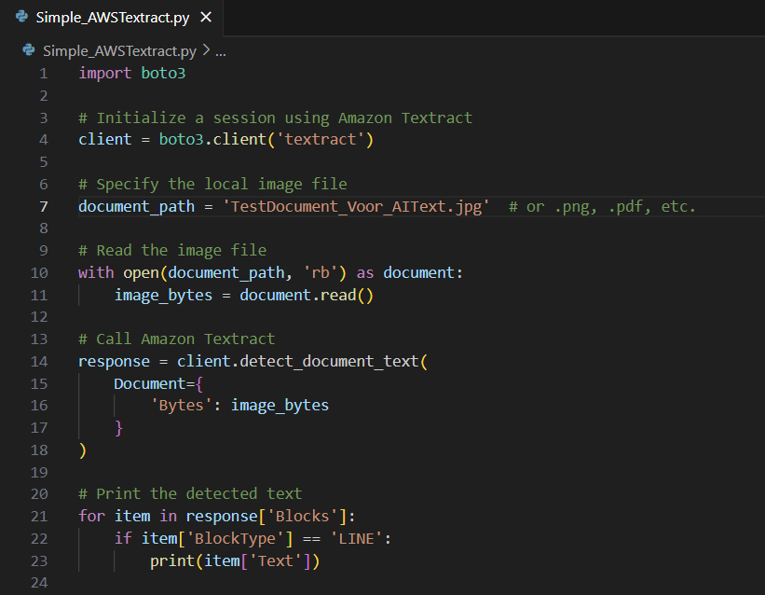
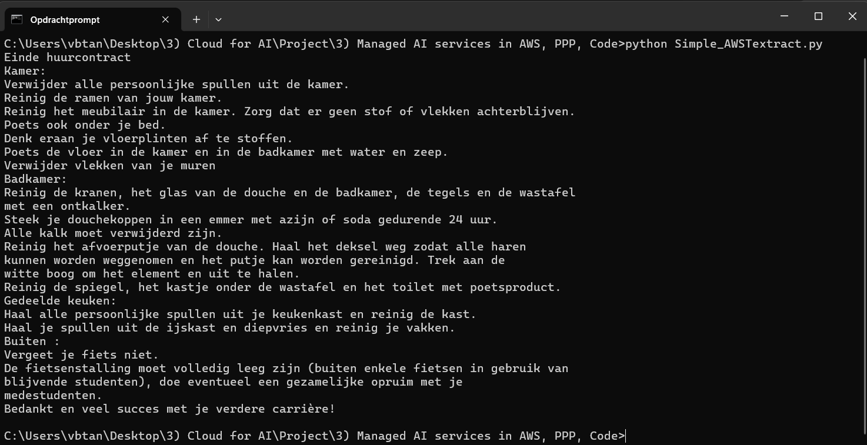
Build a simple python application in which you use the service

